Slide 1
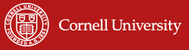
The Favorable Impact of Index-Based Livestock Insurance (IBLI): Results among Ethiopian and Kenyan Pastoralists
Christopher B. Barrett, Cornell University
Workshop on Innovations in Index Insurance to Promote Agricultural and Livestock Development in Ethiopia
Addis Ababa, Ethiopia, December 3, 2015

Slide 2
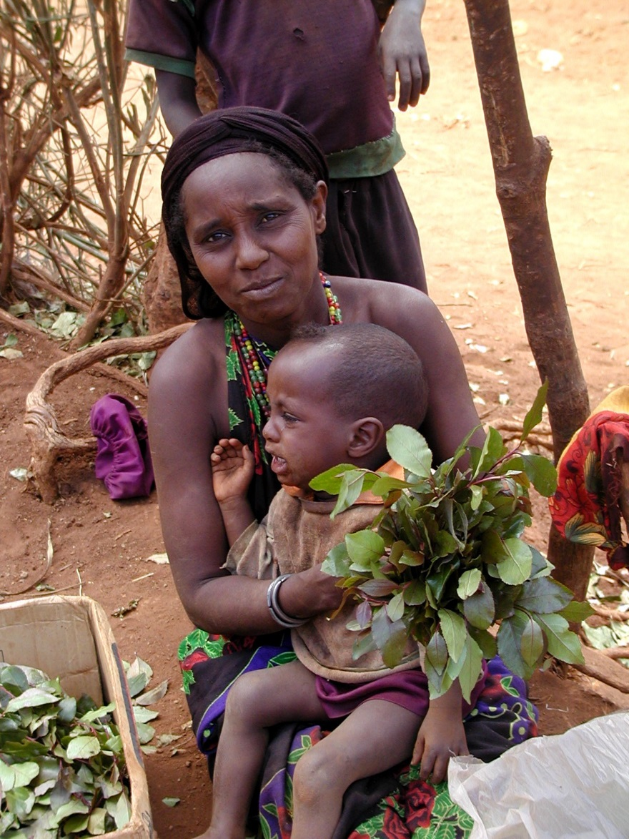
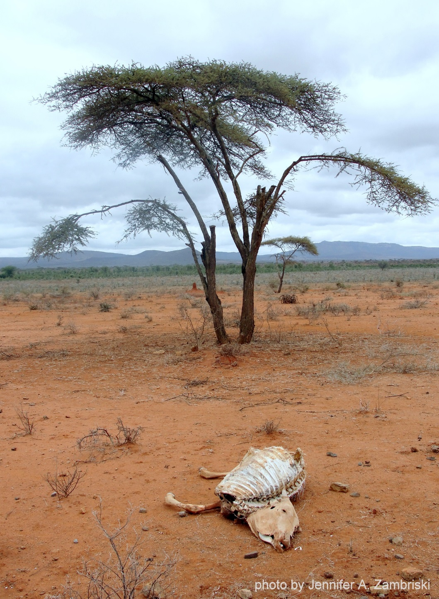
Motivation: Target Population and Events

Slide 3
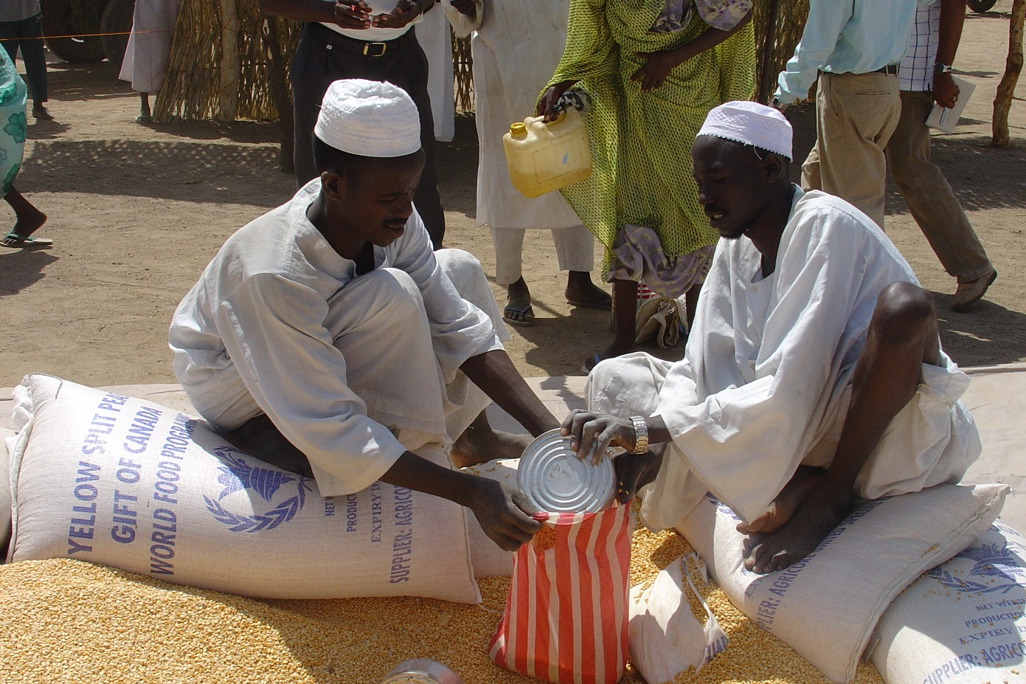
Motivation: Standard Responses to Drought
Standard responses to major drought shocks:
1) Post-drought restocking 2) Food aid
Key Problems:
Slow; Expensive; Reinforce sedentarization

Slide 4
The Potential of Index Insurance
Index insurance is a variation on traditional insurance:
  Payments triggered immediately by an event
  Do not insure individual losses.
  Instead insure some “index” measure that is strongly correlated with individual losses.
  (Examples: rainfall, remotely sensed vegetation index, area average yield, area average herd mortality loss).
  Index needs to be:
    objectively verifiable
    available at low cost in real time
    not manipulable by either party to the contract

Slide 5
The Potential of Index Insurance
Index insurance can obviate the problems that make individual insurance unprofitable for small, remote clients:
  - No transactions costs of measuring individual losses
  - Preserves effort incentives (no moral hazard) as no single individual can influence index
  - Adverse selection does not matter as payouts do not depend on the riskiness of those who buy the insurance
Index insurance can perhaps create a timely, commercially-provided, financially sustainable, self-targeting safety net to protect pastoralists against catastrophic drought shocks.
Could also accelerate herd recovery, altering herd dynamics and averting system collapse if drought frequency increases.

Slide 6
The Major Challenges of Index Insurance
High quality data (reliable, timely, non-manipulable, long-term) to design/price product and to determine payouts
Minimize uncovered basis risk through product design. Is it insurance or a lottery ticket? The answer turns on basis risk.
Innovation incentives for insurers/reinsurers to design and market a new product and global market to support it
Establish informed effective demand, especially among a clientele with little experience with any insurance, much less a complex index-based insurance product
Low cost delivery mechanism for making insurance available for numerous small and medium scale producers

Slide 7

(Jensen, Barrett &2014)
Index-Based Livestock Insurance: Design
The signal: Normalized Difference Vegetation Index (NDVI) collected by satellite
Response function: In northern Kenya, regress historic livestock mortality onto transforms of historic cumulative standardized NDVI (Czndvi) data. In Borana, just NDVI. Designed to minimize household-level basis risk.
Indemnity payments: In Kenya, predicted livestock mortality >15% according to:
$max\left[{index}_{d,t}({\overline{L}}_{d,t}, μ_{d,t})−0.15, 0 \right]∗value of livestock insured$
Temporal Structure of IBLI contract:
12 month contract sold during 2-month sales windows just prior to usual start of seasonal rains. Payouts March 1 and/or October 1.
Chantarat et al. JRI 2013

Slide 8
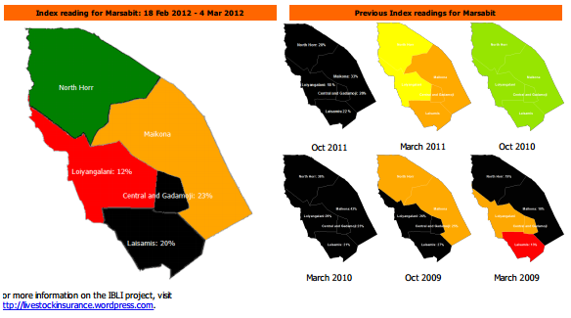
(Jensen, Barrett &2014)
Index-Based Livestock Insurance: Implementation
Commercial underwriters: In Kenya: UAP, APA, Takaful. In Ethiopia: OIC
International reinsurers: Swiss Re, Africa Re
Lots of implementation challenges
IBLI team developed extension/
financial education programs to
(randomly) inform prospective buyers.
IBLI team (randomly) distributed
discount coupons to induce uptake and
to establish price elasticity of demand.
Payouts in Kenya in Oct 2011, Mar 2012,
March 2014
Payouts in Ethiopia in Nov 2014

Slide 9
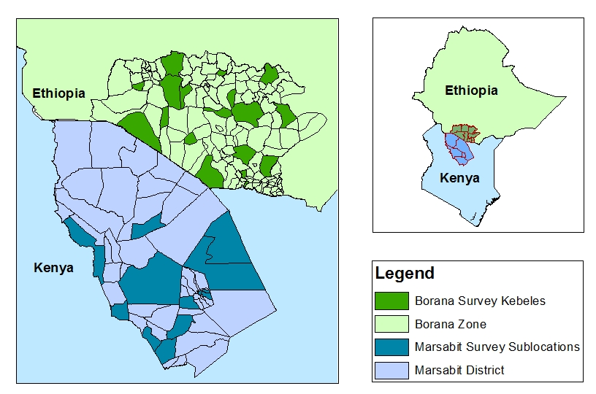
(Jensen, Barrett &2014)
IBLI Pilots in Ethiopia and Kenya
IBLI products (surveys) launched in Marsabit, Kenya in Jan 2010 (Oct 2009) and in Borana, Ethiopia, in Aug 2012 (Mar 2012).
Kenya sampling overlaid with HSNP coverage as research design.

Slide 10
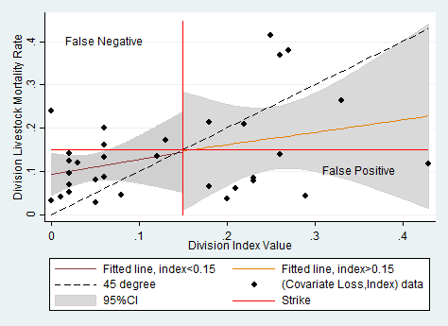
(Jensen, Barrett & Mude 2014)
IBLI: Significant Basis Risk Remains
Covariate risk is important but household losses vary a lot …
and the index does not perfectly track covariate losses.
Notes: The left figure illustrates the covariate (average) loss rate in each season. The right figure illustrates the distribution of losses within each seasons. The boxes depict the interquartile range, the upper and lower adjacent values are either 3/2 the interquartile range or the value furthest from the median. The remaining observations fall outside the adjacent values.
Notes: Covariate loss-index observations are seasonal division average mortality paired with the index value for that division-season. Fitted lines and confidence intervals are generated by regressing livestock mortality rates on the index.
- IBLI hhs still hold most risk: 62-77% of total risk exposure remains
- Most basis risk is idiosyncratic and random, not targetable or correctable.
- Significant spatial variation in covariate share – geographically target IBLI?
Jensen, Barrett & Mude 2014

Slide 11
(Jensen, Barrett &
IBLI: An Imperfect Product
Because of basis risk, esp. false negatives, IBLI cannot stochastically dominate no insurance.
Survival rate w/o insurance (L) and net of prem/indemnity payments w/IBLI (R).
Note: - small probability of negative survival rates!
- increased dispersion of outcomes due to false payments>losses
Jensen, Barrett & Mude 2014

Slide 12
IBLI Uptake Significant … But So Is Disadoption
In HH surveys , in Borana (Ethiopia)/Marsabit (Kenya):
47/48% ever purchased IBLI within first 4 sales periods
But repurchase rates low: 18-68%/16-27%
High rates of disadoption : 20/31% within 2 years
Sample restricted to 489/820 panel households.

Slide 13
IBLI Uptake Is Also Predictable …
Capacity to predict uptake patterns is reasonably strong:
Unconditional observed / predicted (Cond. FE) likelihood of buying IBLI
Observed / predicted (Cond. FE) level of purchases (|buying IBLI)

Slide 14
Key determinants of IBLI uptake
General uptake findings — robust across specifications and surveys
Price: Responsive to premium rate (price inelastic). Price elasticity grows w/design risk.
Design Risk: Design error reduces uptake; greater effect at higher premium rates.
Idiosyncratic Risk: Hh understanding of IBLI increases effect of idiosyncratic risk
Understanding: Extension/marketing improves accuracy of IBLI knowledge but no independent effect of improved understanding on uptake.
Herd size: Likelihood of uptake increasing in HH herd size
Liquidity: IBLI purchase increasing w/HSNP participation
Intertemporal Adverse Selection: HHs buy less when expecting good conditions.
Spatial Adverse Selection: Divisions with relatively more covariate risk see higher uptake and level of coverage increases with variation in division average losses.
Gender: no gender diff in uptake. Women more sensitive to risk of new product.
Bageant & Barrett 2015; Jensen, Mude & Barrett 2014; Takahashi et al. 2014

Slide 15
IBLI’s Impacts: Herd mortality risk
Proportion of households for whom IBLI improves their
position with respect to each statistic
Statistic | Proportion
 | Loaded & Unsubsidized | Subsidized
Mean | 0.232 | 1.000
Variance | 0.359 | 0.359
Skewness | 0.817 | 0.817
Semi-Variance | 0.374 | 0.609
Proportion of households that are better off with IBLI than without (Simulated utility analysis)
Jensen, Barrett & Mude 2014

Slide 16
IBLI’s Impacts: Livestock productivity/income
 |  | IBLI
Dependent Variable |  | Cumulative Past Coverage | Current Coverage (TLU)
Production strategies:
Herd Size |  | -5.634*** | -0.270
 |  | (1.970) | (0.693)
 |  |  | [3.543]
Veterinary Expenditures (KSH) |  | 584.8* | -46.21
 |  | (324.7) | (127.2)
 |  |  | [15.17]
Household is Partially or Fully Mobile |  | -0.0669 | 0.0386
 |  | (0.111) | (0.0481)
 |  |  | [14.86]
Production outcomes:
Milk income (KSH) |  | 1,688* | 840.6*
 |  | (970.0) | (473.6)
 |  |  | [11.46]
Milk income per TLU (KSH) |  | 423.5*** | 63.81
 |  | (118.1) | (47.23)
 |  |  | [13.05]
A complete list of covariates, coefficient estimates, and model statistics can be found in Jensen, Mude & Barrett (2014). Clustered and robust standard errors in parentheses. Model F-stat in brackets. *** p<0.01, ** p<0.05, * p<0.1.
IBLI coverage:
Increases investments in maintaining livestock through vet expenditures
Increases total and per TLU income from milk.
Note: TLU veterinary expenditures are pos/sign related to milk productivity
Jensen, Barrett & Mude 2014

Slide 17
IBLI’s Impacts: Less adverse post-drought coping
Marsabit HHs received IBLI indemnity payments in October 2011, near end of major drought. Survey HHs with IBLI coverage report much better expected behaviors/outcomes than the uninsured:
36% reduction in likelihood of distress livestock sales, especially (64%) among modestly better-off HHs (>8.4 TLU)
25% reduction in likelihood of reducing meals as a coping strategy, especially (43%) among those with small or no herds
IBLI appears to provide a flexible safety net, reducing reliance on the most adverse behaviors undertaken by different groups.
Janzen & Carter 2013 NBER

Slide 18
Insurance vs. cash transfers: Normalized by cost
IBLI generates comparable impact/KSh on average at pilot scale. But philanthropic/public funding is largely fixed cost, so the marginal benefit/cost ratios are > an order of magnitude larger!
All in real 2009 Kenya Shillings. Impacts are estimated using the average client value and costs from administrative records, and parameter estimates. ¹Results are multiplied by 10. ²Results are multiplied by 1,000.
Jensen, Barrett & Mude 2014

Slide 19
IBLI’s Impacts: Household subjective well-being
Borana survey HHs report overall life satisfaction. In principle, insurance helps risk averse people even when it doesn’t pay out. But an imperfect product with commercial loadings might not.
There had been no payout in Ethiopia (pre-11/14). So use subjective well-being measures to assess welfare gains even w/o indemnities.
To deal with potential heterogeneity problems associated with SWB (attitudinal measures), we correct our SWB measures using hypothetical vignettes, using current best practice, and verify with alternative measures to ensure robustness of findings.
Tafere , Barrett, Lentz and Taddesse. 2014

Slide 20
IBLI’s Impacts: Household subjective well-being
  Use randomized treatments to instrument for IBLI and then estimate how IBLI contracts in force and lapsed IBLI coverage affect SWB.
There are at least two ways IBLI can influence SWB:
  1) Non-monetary (psychological) benefits or costs
    Insurance may give peace of mind about adverse outcomes
    Insurance could increase stress if basis risk is high
    Buyer’s remorse wrt lapsed contracts
  2) Monetary benefits or costs – effect on net income/wealth
    Since premium payment reduces net income/wealth, indemnity payment increases it, net indemnity payments will influence SWB.
Tafere, Barrett, Lentz and Taddesse. 2014

Slide 21
IBLI’s Impacts: Household subjective well-being
Key Findings:
IBLI has a positive, stat. sig. effect on HH well-being, even after premium payment and w/o any indemnity payments
  IBLI coverage for 3 TLU moves a HH 1 step up the SWB scale
  Insuring 15 TLU (roughly baseline sample mean herd size) shifts HH from lowest to highest SWB category
Ex post of contract lapse, purchasers exhibit some buyer’s remorse in the absence of indemnity payments.
But the positive effect of IBLI coverage is significantly higher than the negative effect of buyer’s remorse.
Even with prospective buyer’s remorse, IBLI purchase improves subjective well-being.
Tafere , Barrett, Lentz and Taddesse. 2014

Slide 22
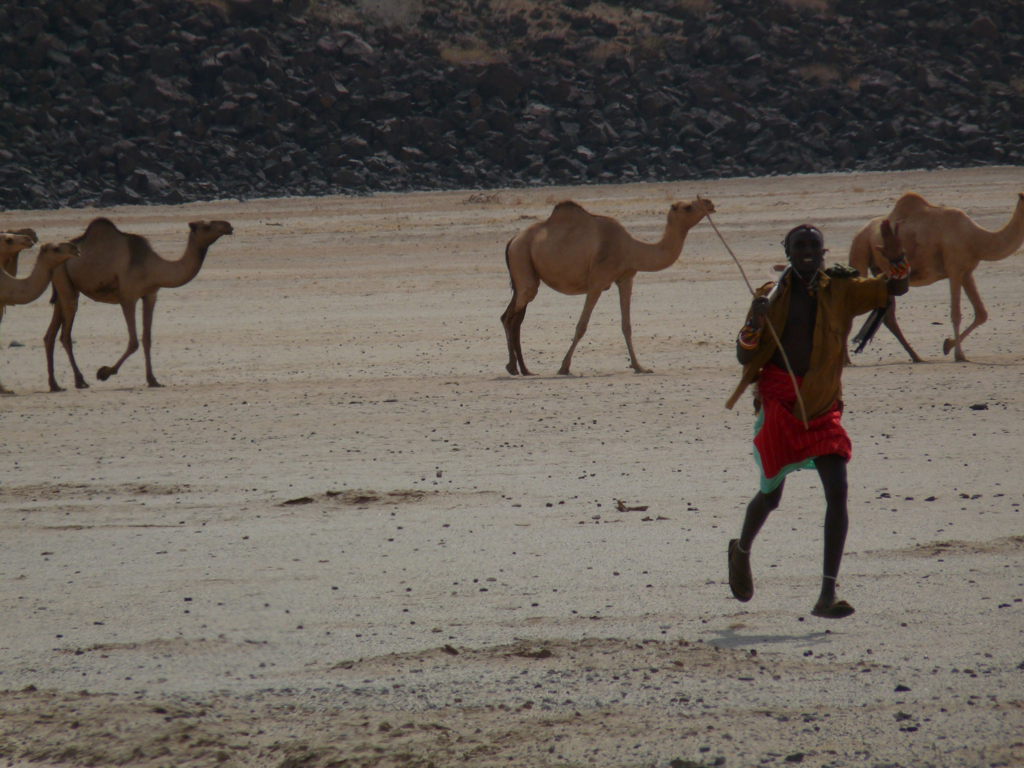
Although IBLI offers incomplete coverage against herd loss and will not help all people, uptake is solid and privately-provided IBLI has clear favorable impacts on purchasers.
IBLI offers a promising option for addressing poverty traps that arise from catastrophic drought risk … and impacts/$ > cash transfers
Thank you for your time, interest and comments!
For more information visit www.ilri.org/ibli/
Notes:
22

